Slide 1



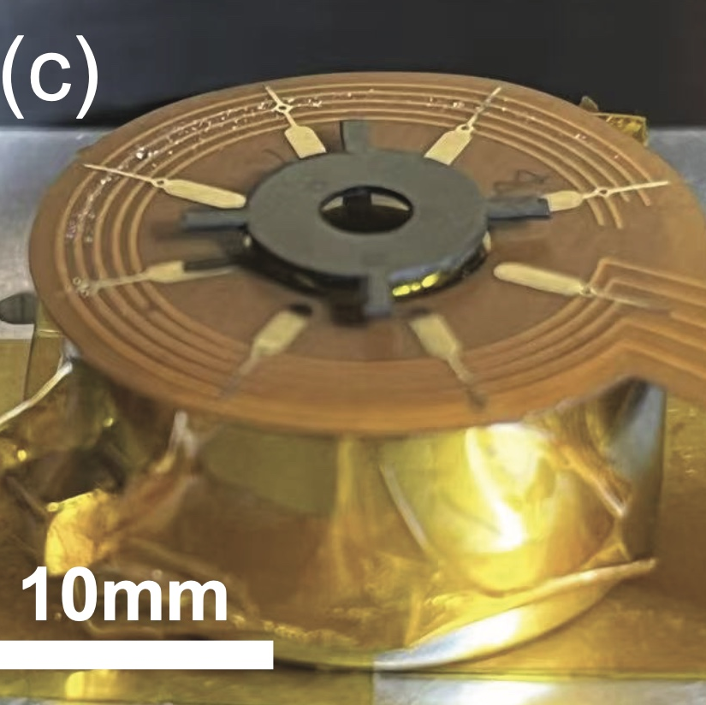

A*STAR
Physics-Informed Machine
Learning for a Levitating Rotor
23 July 2025
Content Breakdown:
Defining/Clarifying the Problem
PINN Testbed 1
PINN Testbed 2
Apply FFT to PINN

Slide 2



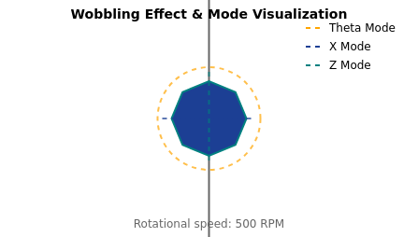
The Challenge: Wobbling at High Speeds
The Wobble Eﬀect
Three Axes of Rigid Body Modes
At 500 RPM, the rotor begins to wobble dramatically
During experimental runs, three distinct axes of vibration were identiﬁed:
This wobbling indicates a loss of stability in the
system
Theta Mode
X Mode
Z Mode
Discovered this threshold through
Rotational vibration
Horizontal vibration in
Vertical vibration along
careful observation
around the central
the plane of rotation
the axis of rotation
Seek to understand why this
vertical axis
happens
Resonance & Energy Transfer
When rotational frequency matches a mode's natural frequency, resonance
occurs
In experimental data, larger vibrational amplitudes appear at resonance
Suspect coupling generates a driving force on the rotating rotor
This driving force could cause energy transfer from rotation to the vibrational
modes
Visualization of the wobbling eﬀect at 500 RPM
8 / 21

Slide 3
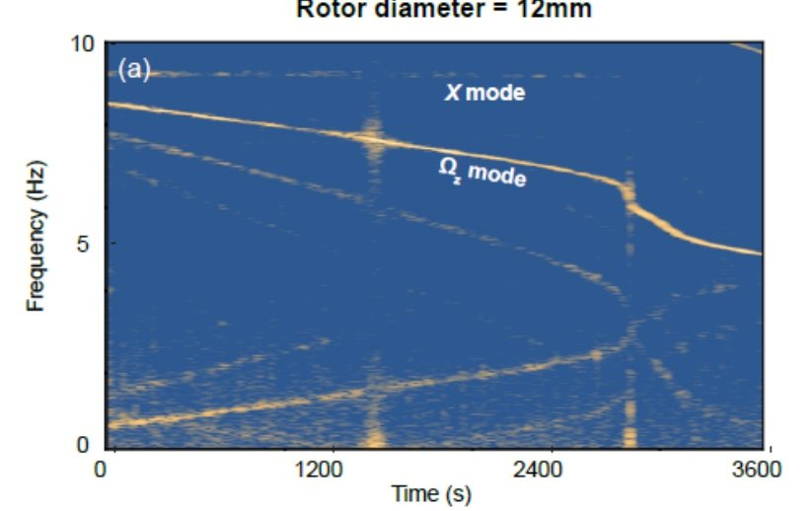
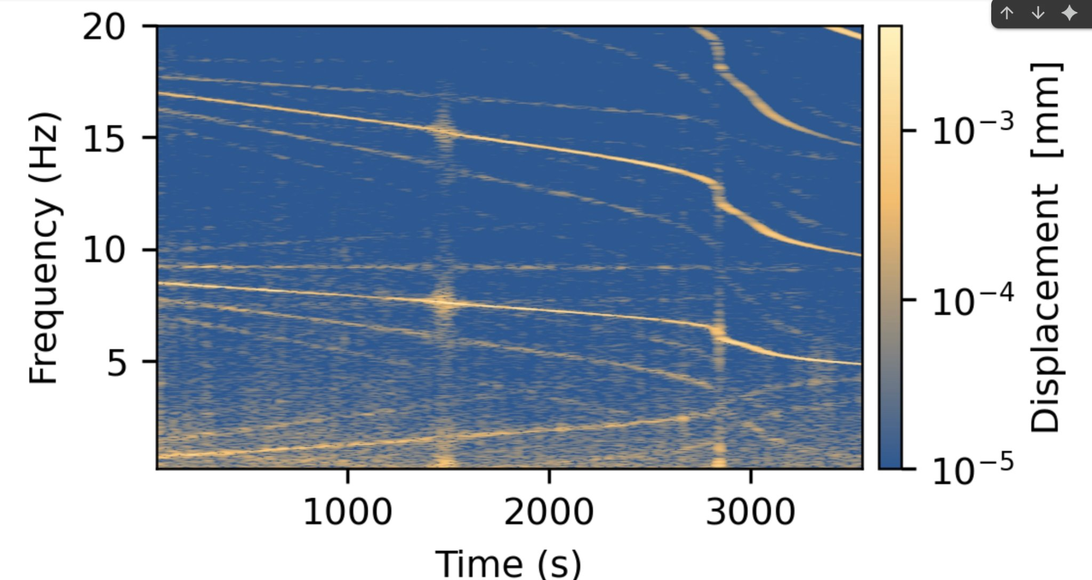
Mode Coupling & Resonance Eﬀects
Frequency-Amplitude Relationship
Key Observations
At 500 RMP, rotor exhibits dramatic wobbling
Three rigid body modes identiﬁed: Theta, X, and Z
Resonance occurs when rotational frequency
matches mode's natural frequency
Energy Transfer Mechanism
Coupling between rotation and vibration modes creates
a driving force that transfers energy from rotation to
vibrational modes, causing the system to ringdown.
PIML identiﬁes coupling between these modes through the presumed driving force
9 / 21

Slide 4
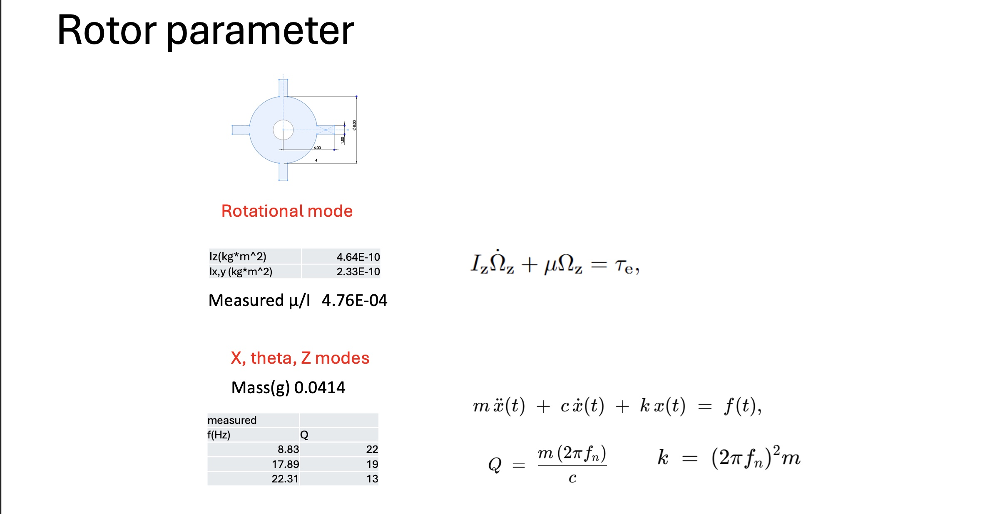
The Physical System

Slide 5
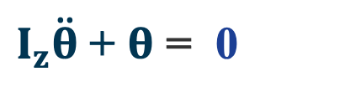
Primary Equation of Motion
The ﬁrst principal equation governing the rotor's rotation about the central vertical axis:
̇
$I_{z}\ddot{θ}$+ $θ$ = 0
I
θ
θ
̇
z
Moment of inertia about the vertical z axis
Angular position of the rotor about the
Angular velocity of the rotor's rotation
of the rotor system
central vertical axis
about the z axis
Key Insight
Setting torque (τ) equal to zero on the right side of the equation simpliﬁes the analysis to focus on the natural dynamics of the system.
This is particularly relevant when investigating the wobbling behavior at high speeds.
7 / 21

Slide 6
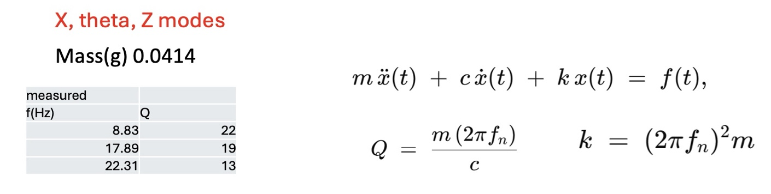




Secondary Equation: Mode Vibration
The second equation describes a second order diﬀerential equation that relates the amplitudes of mode vibrations
to the coupled driving force.
i
i
i
Mode Amplitudes
Coupled System
Driving Force
Describes the vibration amplitudes of the
Models the energy transfers between the
Suspect this force is
three rigid body modes (Theta, X, and Z)
rotating system and the vibrational modes
generated by coupling between the
discovered during experimental runs.
through coupling eﬀects.
modes and the rotating system, causing
energy transfer.
Project Goal: Use PINNs to identify the function of this presumed coupled driving force to investigate its precise generation
mechanism.
10 / 21

Slide 7







Project Roadmap: Six Key Steps
A multi-stage approach designed to build toward analyzing experimental data with Physics-Informed Neural Networks
Step 1
Step 2
Step 3
Script Conversion to JAX
Neural Network for Torque
Physics-Informed Prediction I
Convert Numpy script containing
Prediction
Use physics-informed approach to
equations of motion and numerical
Develop a neural network that predicts
predict the driving force on the system.
Models driving force dependency only on x mode.
solver to JAX framework
the torque of the rotor system based on
simulated data
Step 4
Step 5
Step 6
Physics-Informed Prediction II
FFT Version of PINN
Experimental Data Analysis
Models driving force dependency on x mode
and rotor arms’ angular position theta
Calculated PINN losses via FFT outputs
for simulated x_dot data, since Voltage is function
of x_dot.
Obtain actual experimental data from
collaborators and use it with the
developed Neural Network.
Goal: Identify missing physics equations based on experimental data
13 / 21

Slide 8
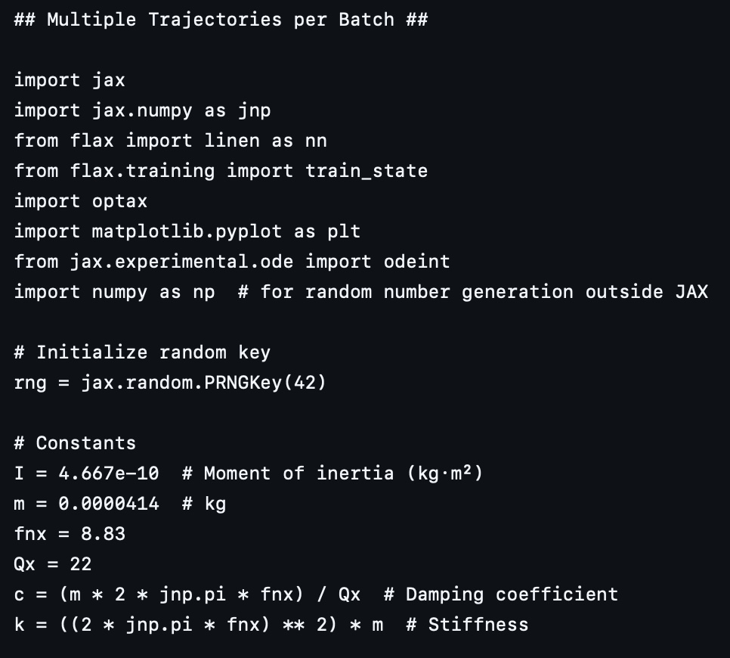
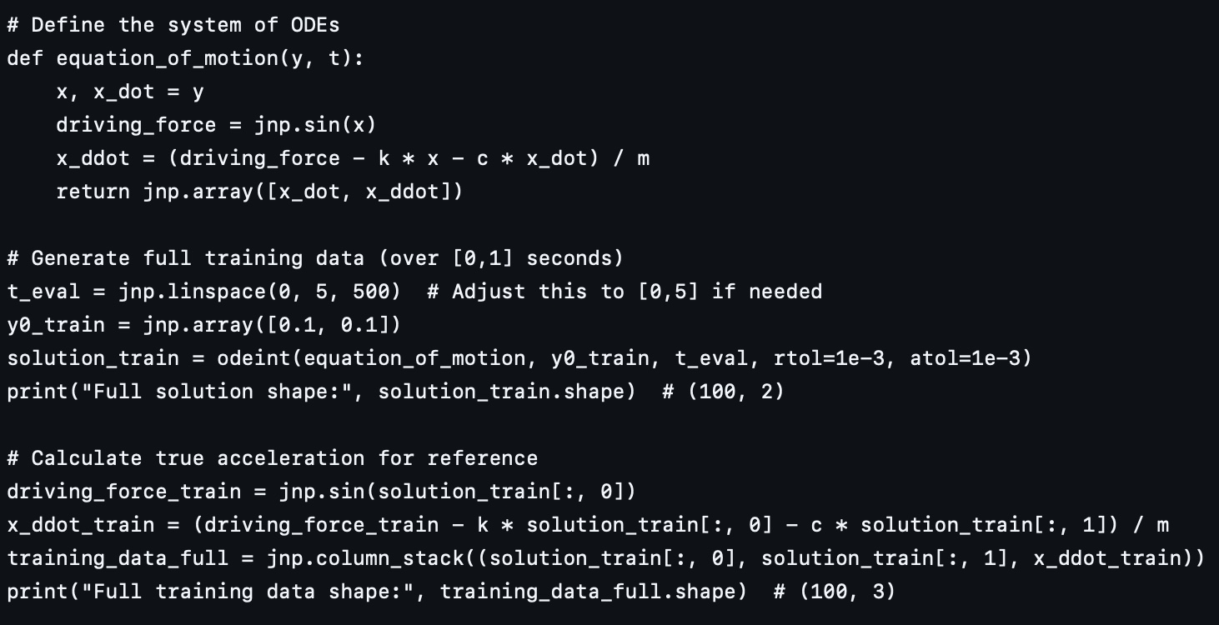
Step 3: Physics-Informed Prediction Approach (I)

Slide 9


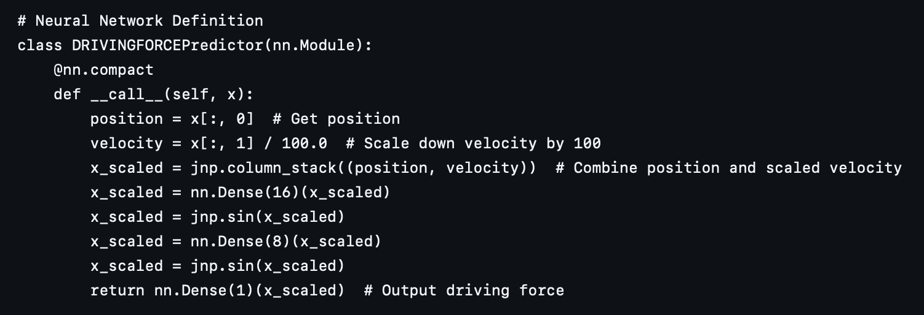


Neural Network Structure
Network Components
Input Layer: Receives x and x_dot values
Hidden Layers: Learn features of input data
Output Layer: Produces torque predictions
Parameters: Weights and biases updated during training
Training Process
Input Layer
Hidden Layers
Loss Function: Mean squared errors between predicted x, x_dot and
Output Layer
actual values
Gradients: Direction of steepest ascent of loss function
Gradient Descent: Taking negative of gradients for optimization
Learning Rate: Controls the size of weight updates
Call ODE Solver: Feed predicted driving force into ODE Solver to attain
predicted x and x_dot
Torque Prediction
Data Pipeline
Theta & Frequency
Feature Learning
Simulation: Generate data using equations of motion
Training: Update parameters to minimize errors
Testing: Validate performance on unseen data
19 / 21

Slide 10
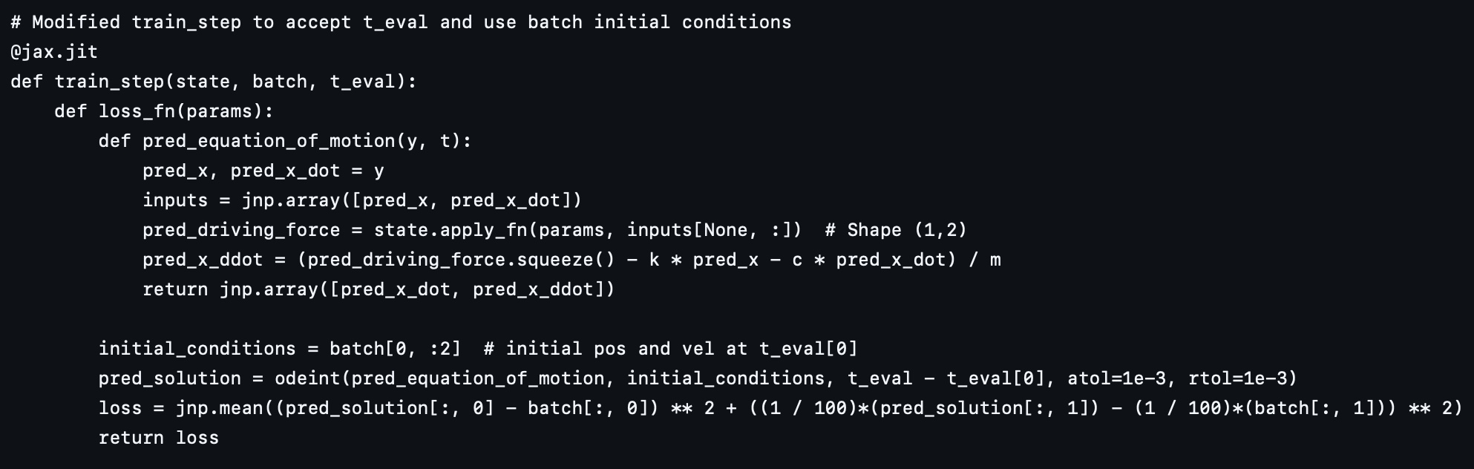
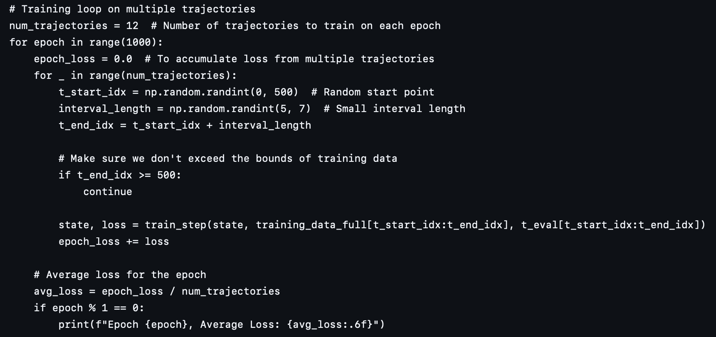
Neural Network Structure

Slide 11
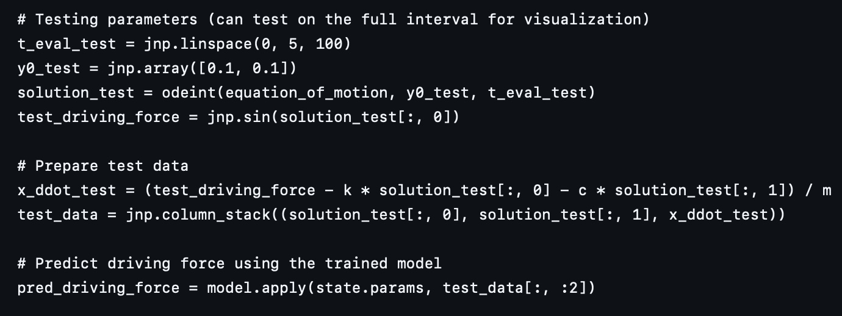
Neural Network Structure

Slide 12
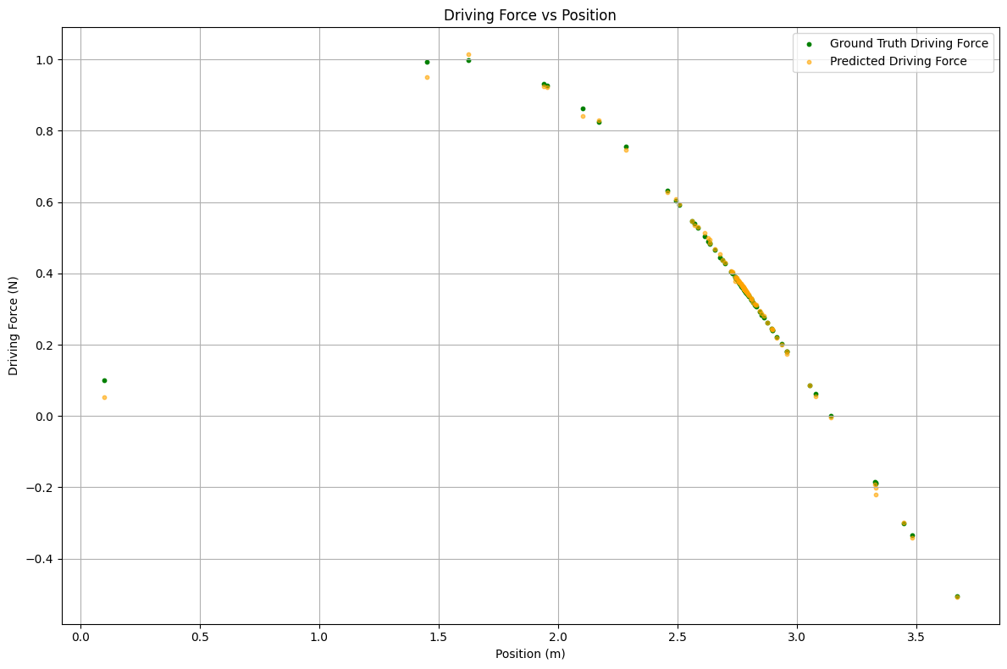
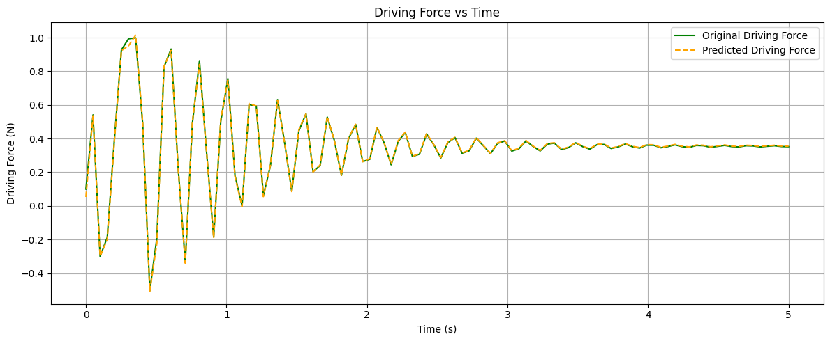
Neural Network Structure

Slide 13
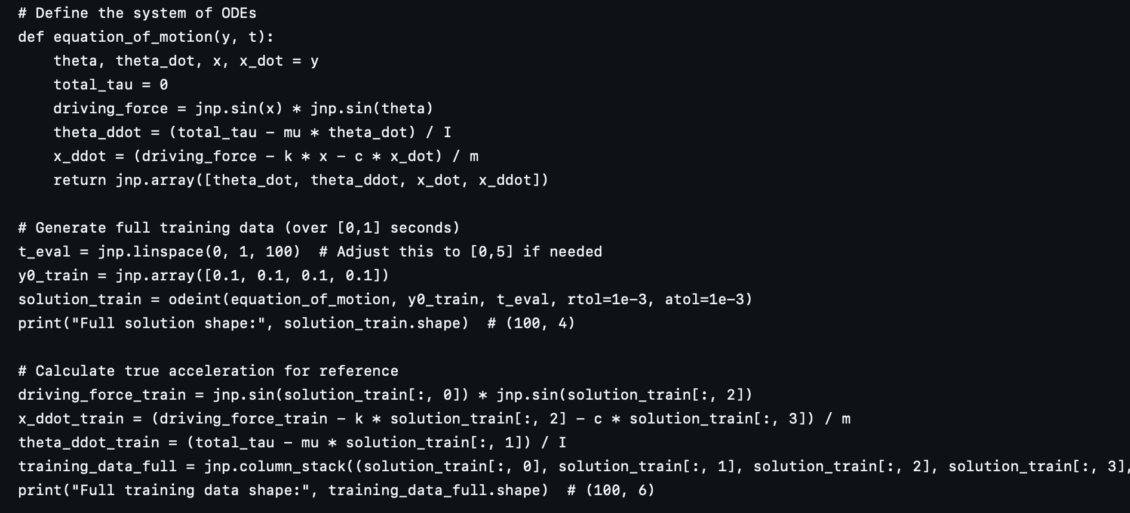
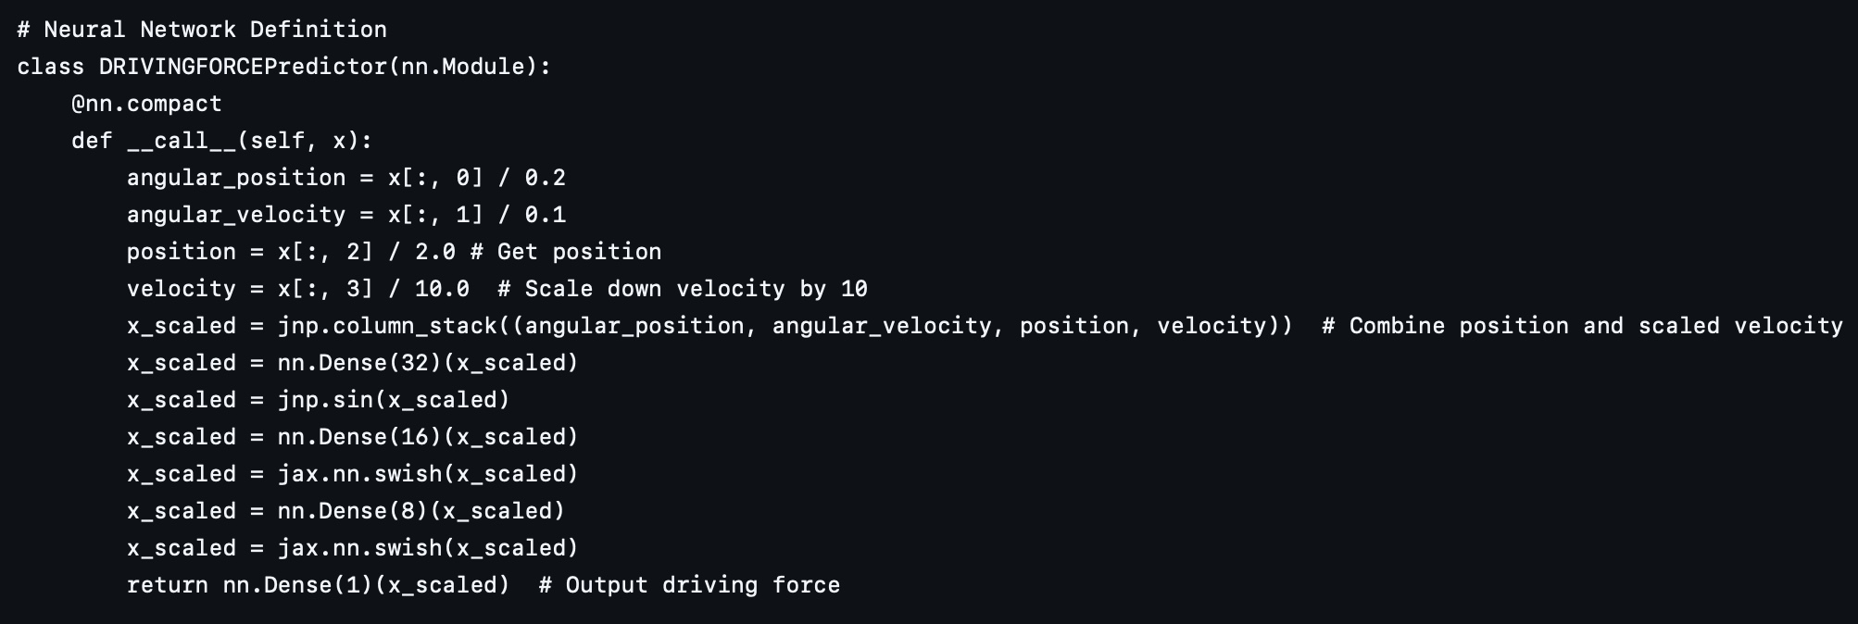
Step 4: Physics-Informed Prediction Approach (I)

Slide 14
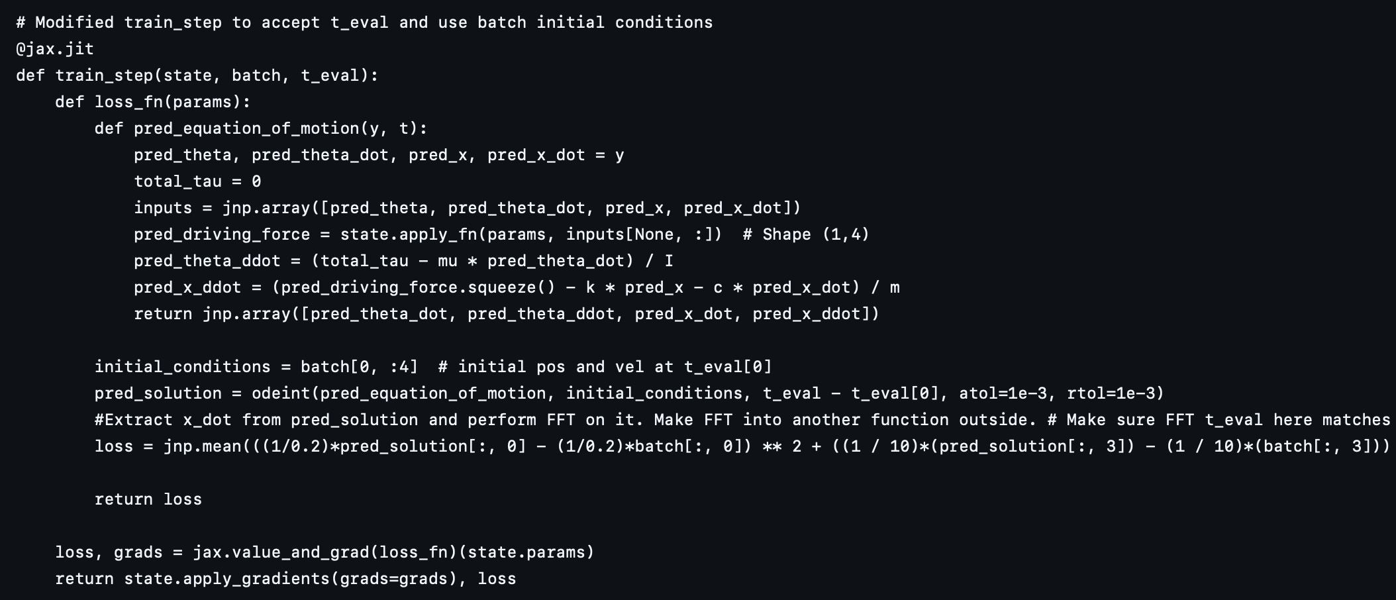
Step 4: Physics-Informed Prediction Approach (I)

Slide 15
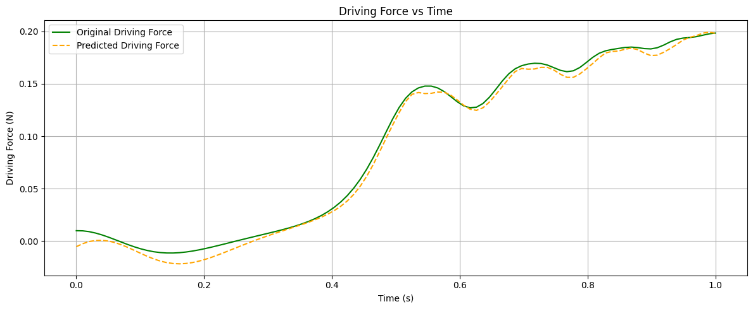
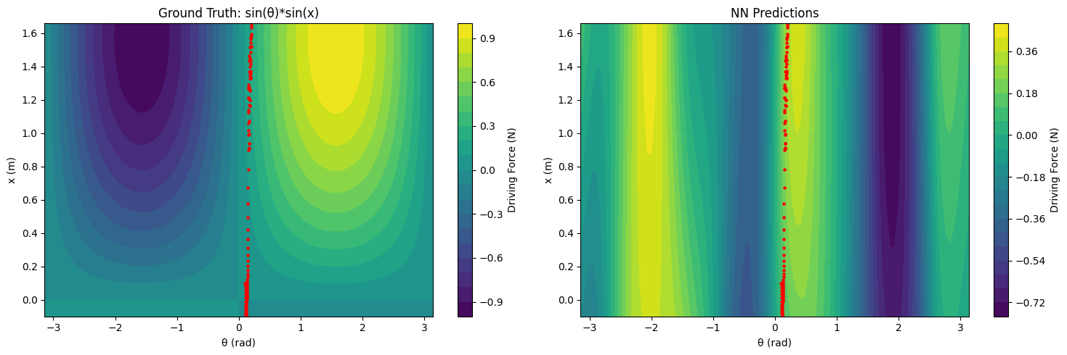
Step 4: Physics-Informed Prediction Approach (I)

Slide 16
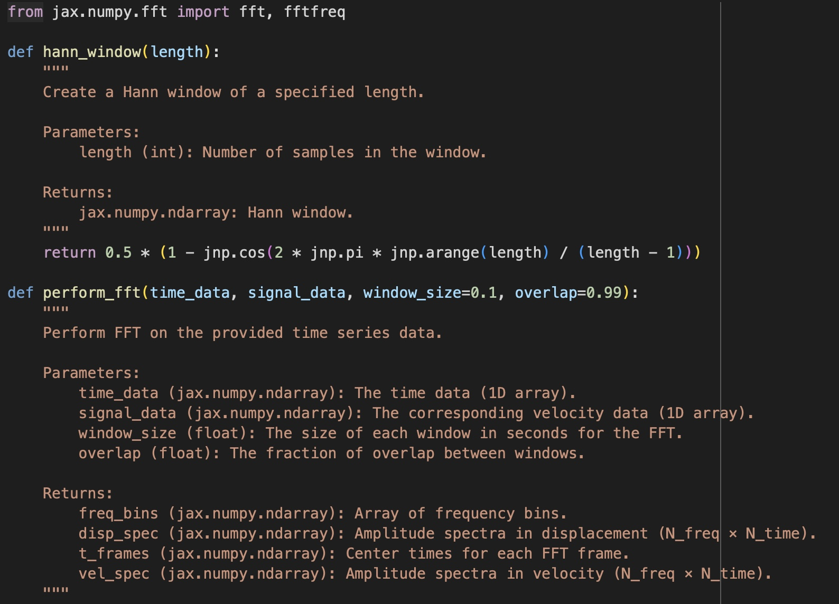
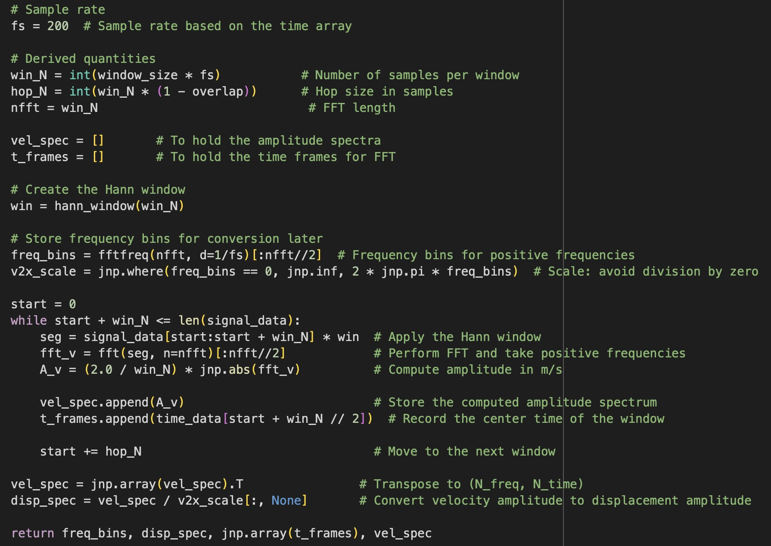
Step 5: FFT Version of PINN

Slide 17
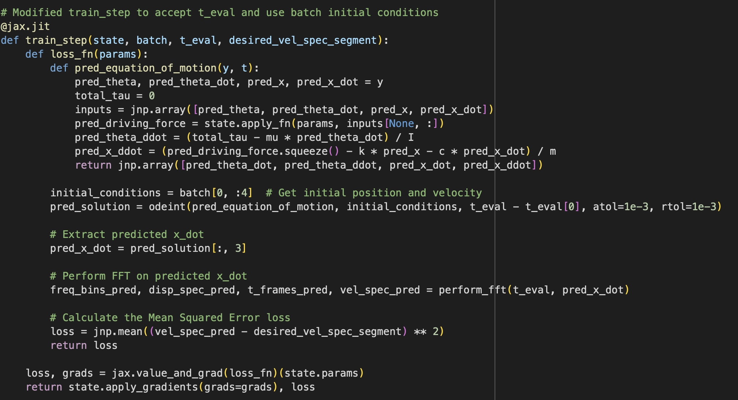
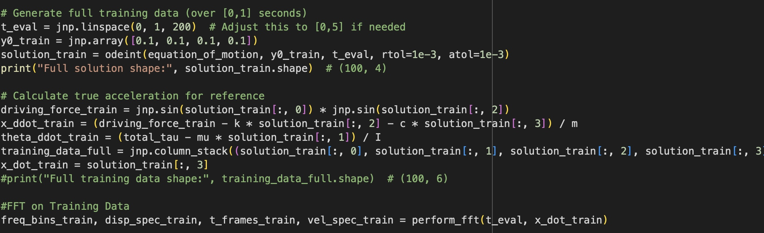
Step 5: FFT Version of PINN

